Slide 1
Presentation on…
Employment application review system (EARS)
Presented by
Md Mahbub alam
ID: 151-35-848

Slide 2
About System
EARS (Employee Application Review System): is a project which is targeted to enhance job application review system & automate manual tasks as best as possible.
This system can be used for Online Job Portal or any other company who wants their job circular system & applicant ranking system to be automated.

Slide 3
System features
Login to Account
Manage Accounts (View, Approve, Delete, Reject)
List all the Application
Profile Management
Search according to Faculty
Add Faculty
Rank Applications (By their skill level)

Slide 4
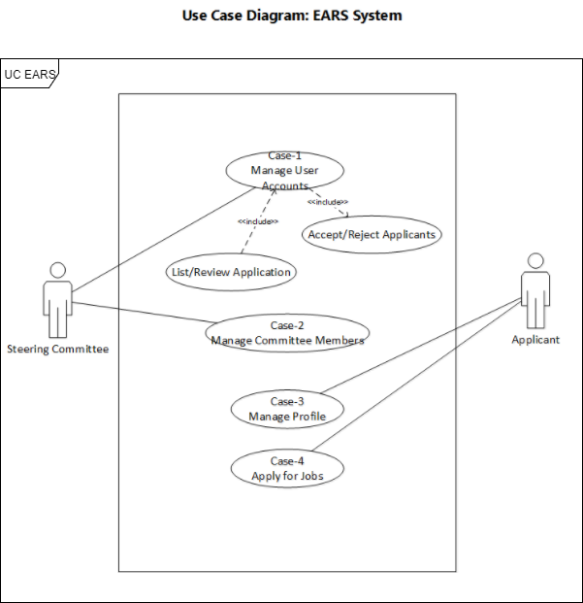
USE Case

Slide 5
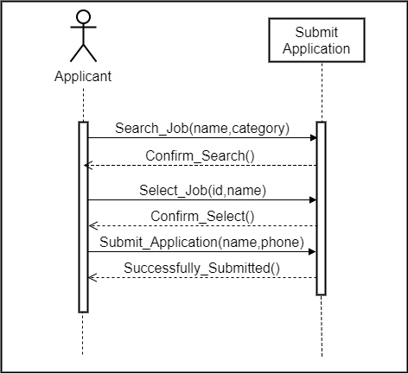
Seq.Diagram: Apply for job

Slide 6
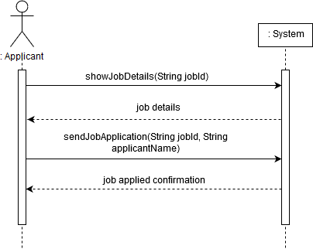
System SeQ. diagram: Submit application

Slide 7

System UI

Slide 8
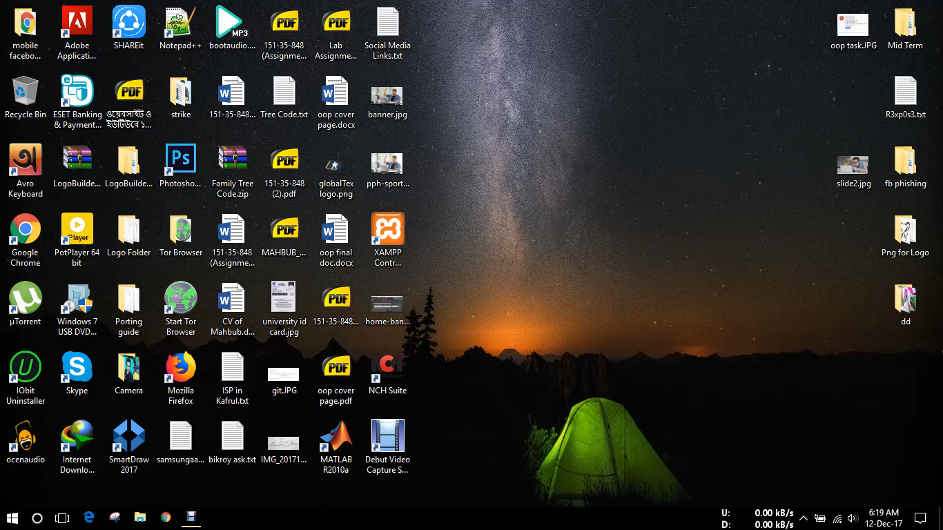
Intro Video

Slide 9
Project Link
Git-Hub Repo Link
https://github.com/mahbub1/Web-Projects

Slide 10
Thank you

